Slide 1
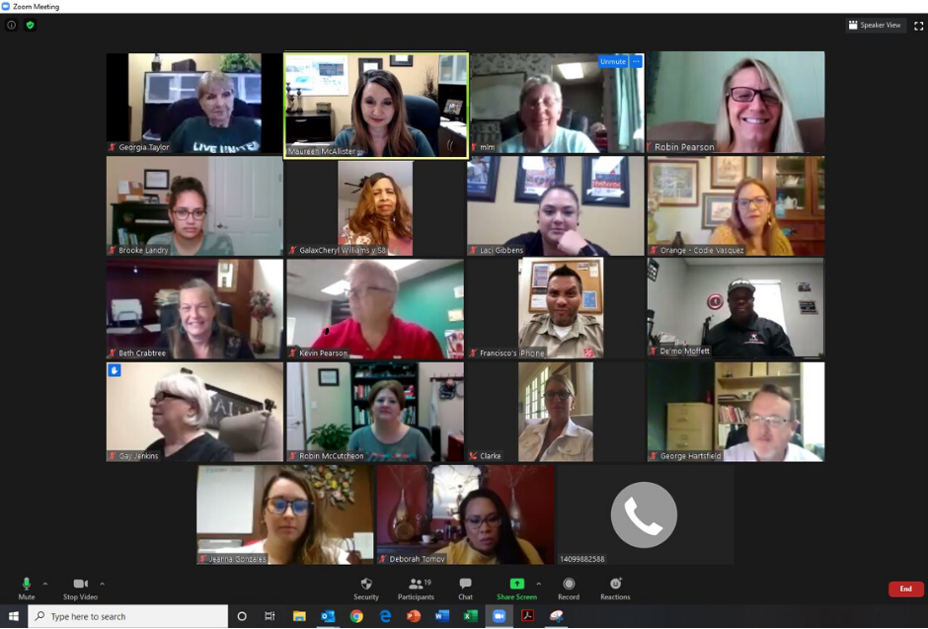


Slide 2

United Way works to improve the health, education, and financial stability of every person in every community. United Way organizations can be found around the globe, all with the same ultimate purpose. The international brand brings many resources
in times of disaster and crisis.

Slide 3
United Way of Orange County works to improve the health, education, and financial stability of every person in Orange County. Much of this work is done through our
Partner Agencies.

Slide 4
Health
We work to improve the physical and mental health, safety, and well-being for people of all ages.
Substance abuse treatment for adults and adolescents
Mental health counseling
Palliative care for end of life patients
Advocates for abused and neglected children
Medical hospitality house
Residential care for boys from unsafe homes
Youth vegetable garden
Trauma services for victims of sexual assault
Suicide intervention
Shelter for women and children from domestic violence
Meals delivered to elderly and disabled
Men’s residential treatment facility
Physical, occupational, and speech therapies
K.I.D.D. ABA (applied behavior analysis) treatment
Equine assisted growth and learning assoc (EAGALA) services
Hippotherapy and therapeutic riding

Slide 5
Education
We work to help children, youth, and adults achieve their full potential.
GED preparation
ESL (English as a second language) classes
After school programs
Summer day camps
Leadership and mentoring
Character and skill building
Special needs vocational training
Adult basic training
Tutoring services
Youth literacy program

Slide 6
Financial Stability
We work to promote financial stability and independence.
Housing, rent and utility assistance
Disaster and crisis assistance
Food pantry
Childcare assistance
Clothing and household items vouchers
Volunteer individual tax assistance

Slide 7
Our Partner Agencies
Anayat House
Boy Scouts - Three River Council
Boys' Haven
Casa of the Sabine Neches Region
Crisis Center of Southeast Texas
Family Services of SETX (Women and Children's Shelter)
Friends Helping Friends
GOALS (Greater Orange Area Literacy)
Jackson Community Center
OCAA (Orange Community Action Association) - Meals on Wheels
OCARC, Inc.
Recovery Council of Southeast Texas – Right Choice of Orange County
Recovery Council of Southeast Texas - Unity Treatment Center
Salvation Army
Salvation Army Boys and Girls Club
Samaritan Counseling Center of Southeast Texas
Shorkey Center
Southeast Texas Hospice
Spindletop Center - Tejas Center
Stable-Spirit
Vidor Children's Fund
YMCA of Southeast Texas

Slide 8
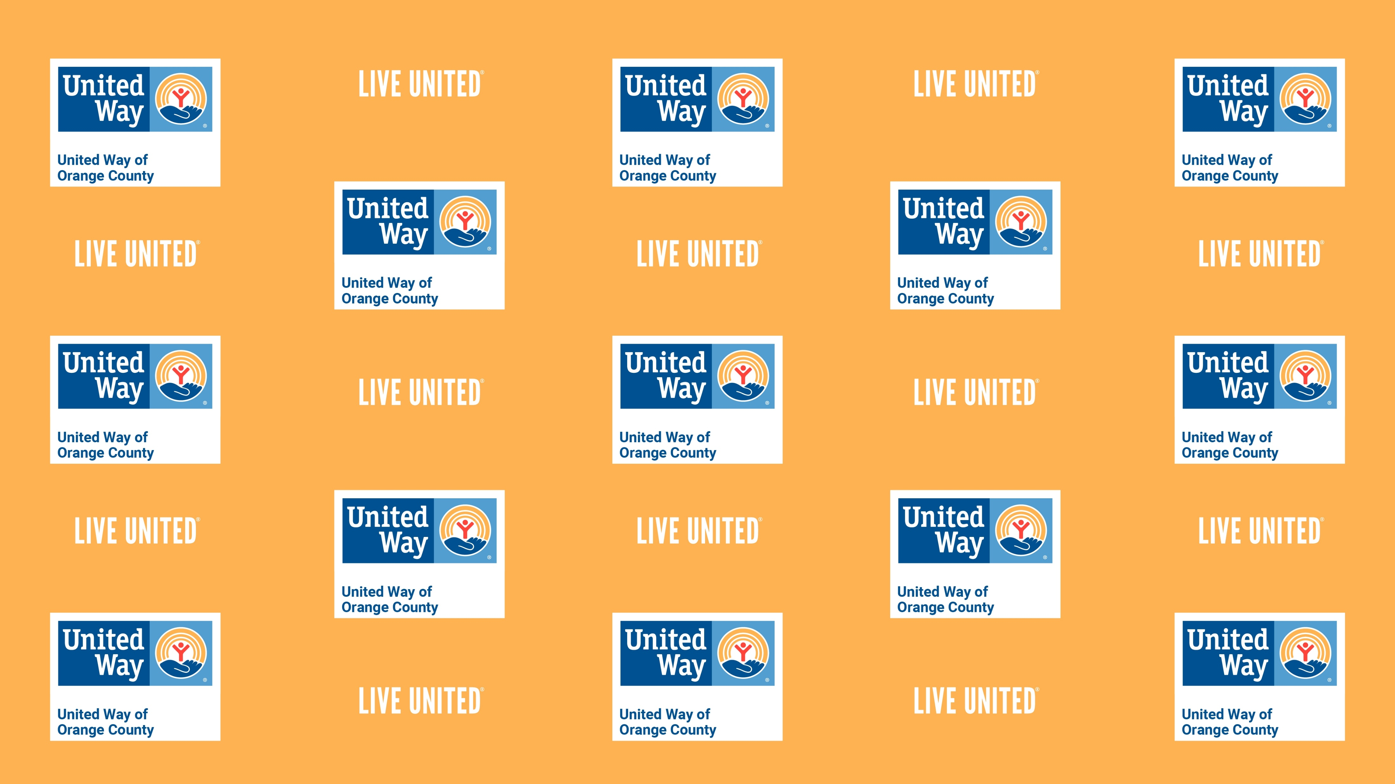
By creating lasting changes in social conditions and preventing problems from happening, we create a stronger and healthier community for everyone.

Slide 9

In addition to the collaboration with our Partner Agencies, we have many other programs to support our community.

Slide 10


EFSP
(Emergency Food and Shelter Program) allows jurisdictions in the United States to receive federal funding for approved agencies which can assist individuals with food, shelter, rent and utilities.

Slide 11
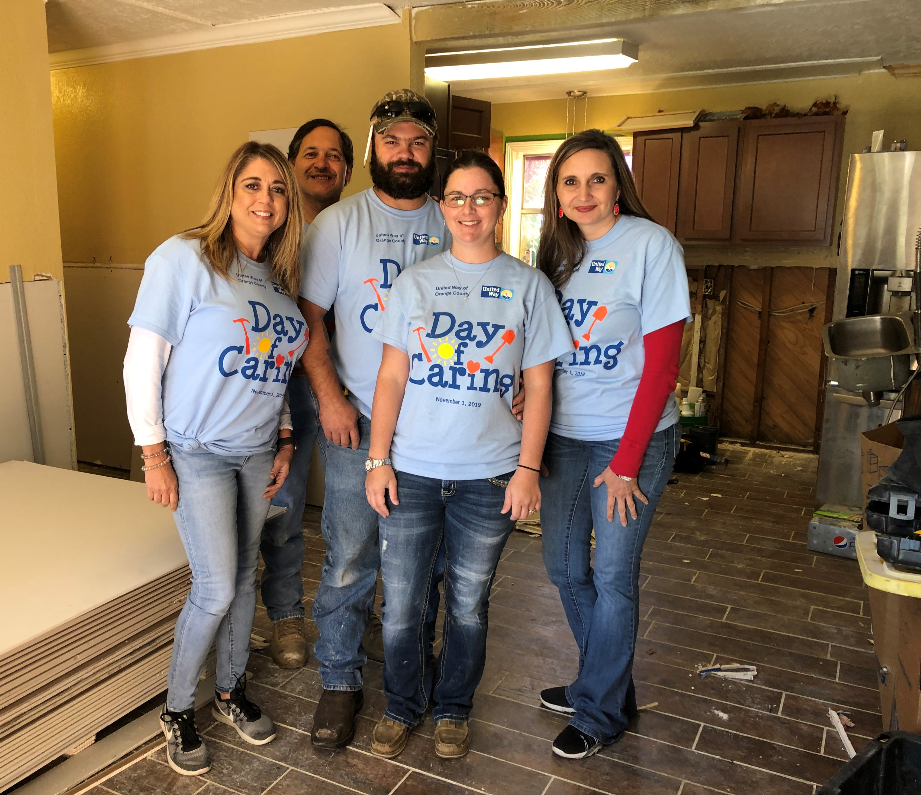
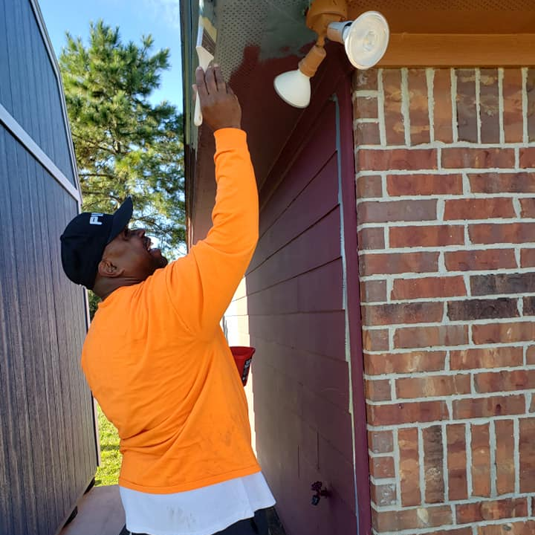
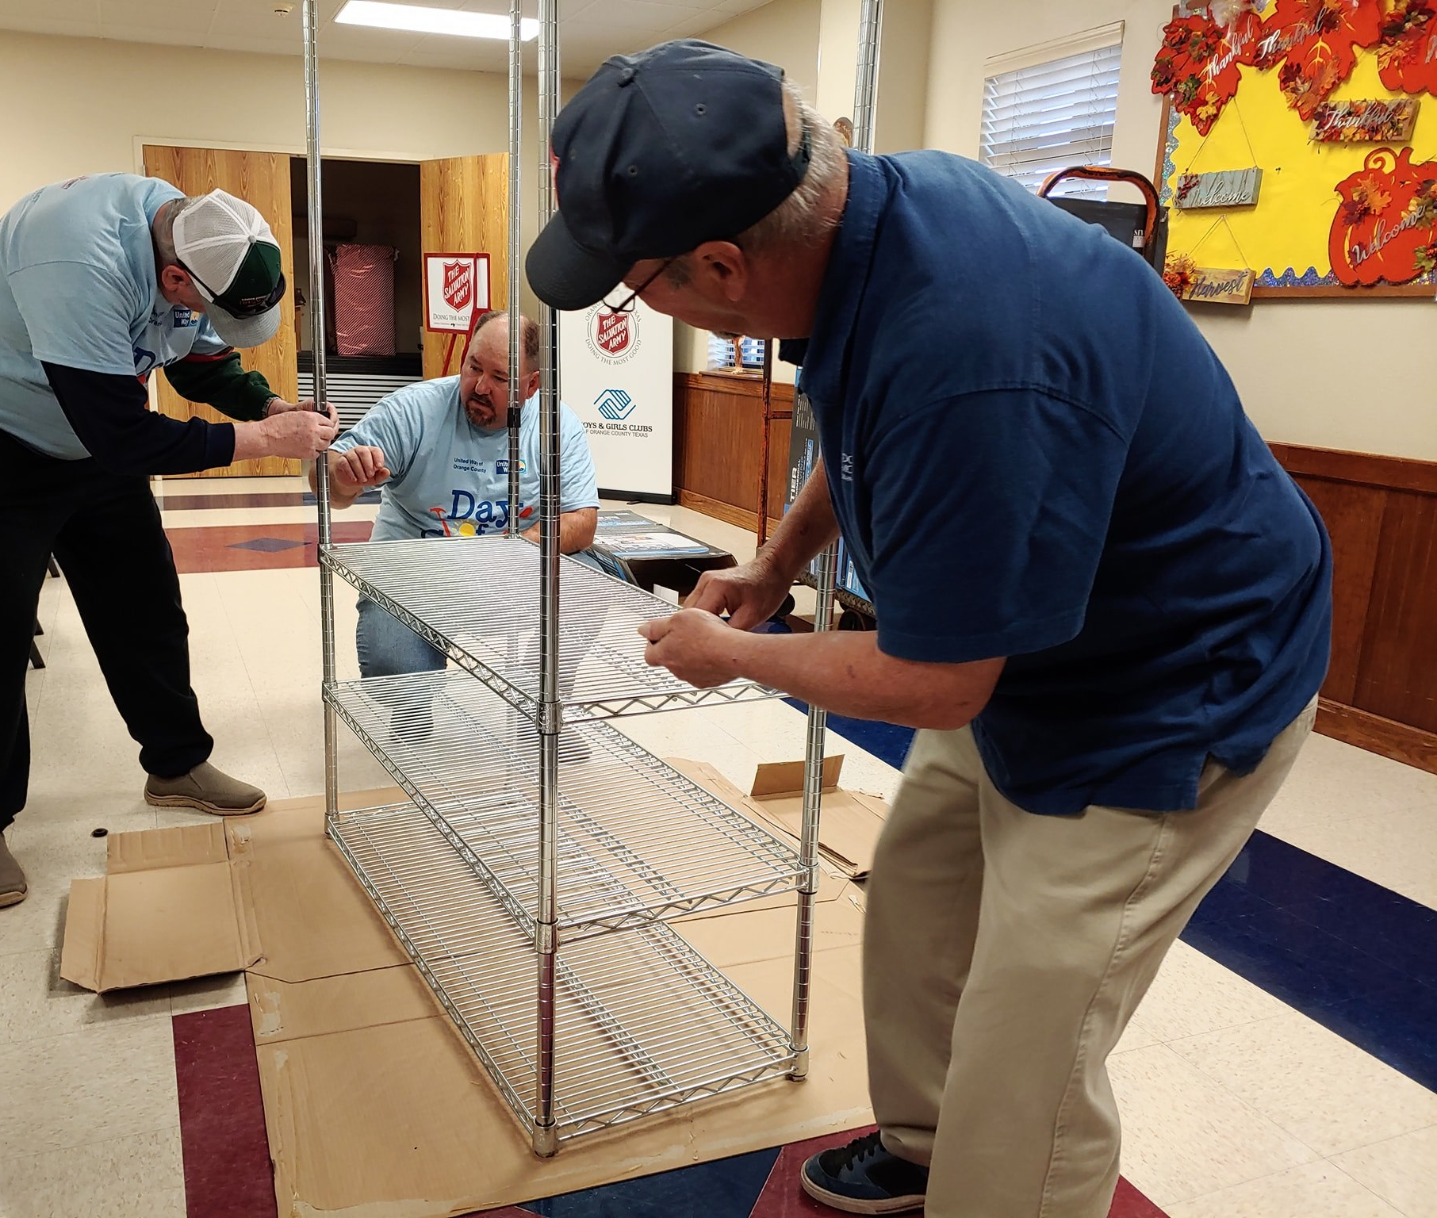
Day of Caring
An annual event where our Corporate Partners take a day to do a service project for one of our Partner Agencies or work to repair a flood-impacted home.

Slide 12

We partner with FamilyWize to increase the Health and Financial Stability of families in our communities. Through their prescription savings card, FamilyWize works to make prescription medications more affordable for all families, so that no one ever has to make the hard choice between the meds they need, and other basics like food or rent.

Slide 13
Disaster Relief/
Crisis Relief
HARVEY RELIEF
Provided over $700,000 of financial assistance
Coordinated approximately $188,000 in relief supplies
Volunteered at multiple distribution events
Distributed 150 pieces of furniture and over 50 mattresses to 62 families
COVID-19 RELIEF
2,000 masks to Partner Agencies and other organizations
Nearly $38,000 in financial assistance to partner agencies and impacted individuals
Organized a community food drive to serve five food pantries
Navigating COVID-19 Roadmap (coming soon)

Slide 14


Slide 15



GIVE – Donate through your employer, online, or mail donations.
ADVOCATE – Get informed, follow our social media, and share our messages.
VOLUNTEER – Give your time and talents to our Partner Agencies and special events.

Slide 16

Why donate through United Way?
Our Partner Agencies are vetted through a very thorough application process every year. Allocations are determined based on need and those amounts are determined by a local Board.
Many companies offer a corporate match. In some cases, that means if you donate $100, your employer may match the contribution for a total donation of $200.
Some of our Partner Agencies rely heavily on funding from us. For example, 90% of the social service dollars distributed by The Salvation Army – Orange are from United Way of Orange County grants.

Slide 17

Your Dollars Make a Difference
$25 an hour of outpatient drug/alcohol counseling
$50 one day of safe transitional housing for abused women and children
$75 three overnight stay for outpatients or caregivers using local medical facilities
$100 two days of occupational training for a client

Slide 18

People can easily create a Facebook birthday fundraiser for
United Way of Orange County and share it with supporters and encourage them to give.

Slide 19


Slide 20



www.unitedwayorangecounty.org
409-883-3591

