Slide 1
Change Doesn’t Happen Alone

Slide 2
United Way fights for the health, education, and financial stability of every person in every community.

Slide 3
We work with local businesses and individuals to raise money to support our Partner Agencies, which provide a direct service to individuals from Orange County. And even though some of the agencies we help are located outside of Orange, they provide a service to people from Orange, a service not offered in Orange. 99% of our funds stay local! The one percent that goes to United Way Worldwide is actually an investment that allows us a multitude of resources and use of the United Way logo. Our Agencies are vetted. They must apply for funding every year and then report their financial status on a quarterly basis.

Slide 4
We support over 20 Partner Agencies who provide direct services to individuals.

Slide 5
Our 2020 Partner Agencies…
Anayat House
Boy Scouts of America - Three Rivers Council
Boys' Haven
CASA of the Sabine Neches Region
Crisis Center of Southeast Texas (Rape and Suicide)
Family Services of SETX (Women and Children's Shelter)
Friends Helping Friends
GOALS (Greater Orange Area Literacy)
Jackson Community Center
OCAA (Orange Community Action Association) - Meals on Wheels
OCARC, Inc.
Salvation Army
Salvation Army Boys and Girls Club
Samaritan Counseling Center of Southeast Texas
Recovery Council of Southeast Texas - Community Coalition
Recovery Council of Southeast Texas - Right Choice of Orange County
Recovery Council of Southeast Texas - Unity Treatment Center
Shorkey Center
Southeast Texas Hospice
Spindletop Center - Tejas Center
Vidor Children's Fund
YMCA of Southeast Texas

Slide 6
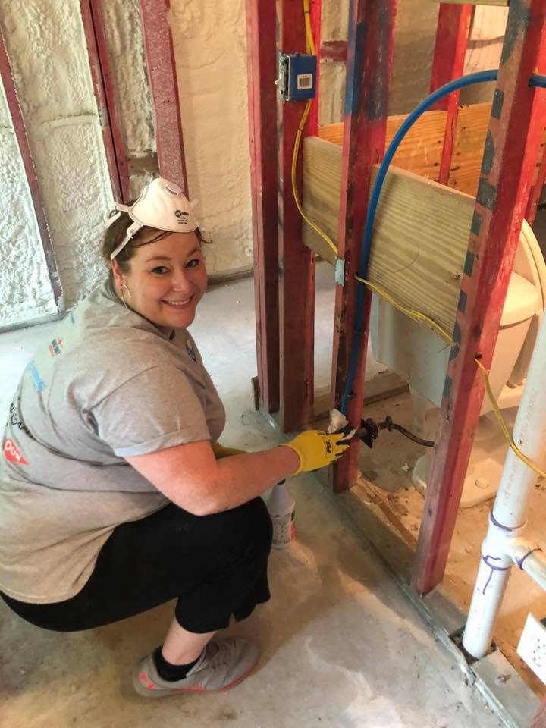
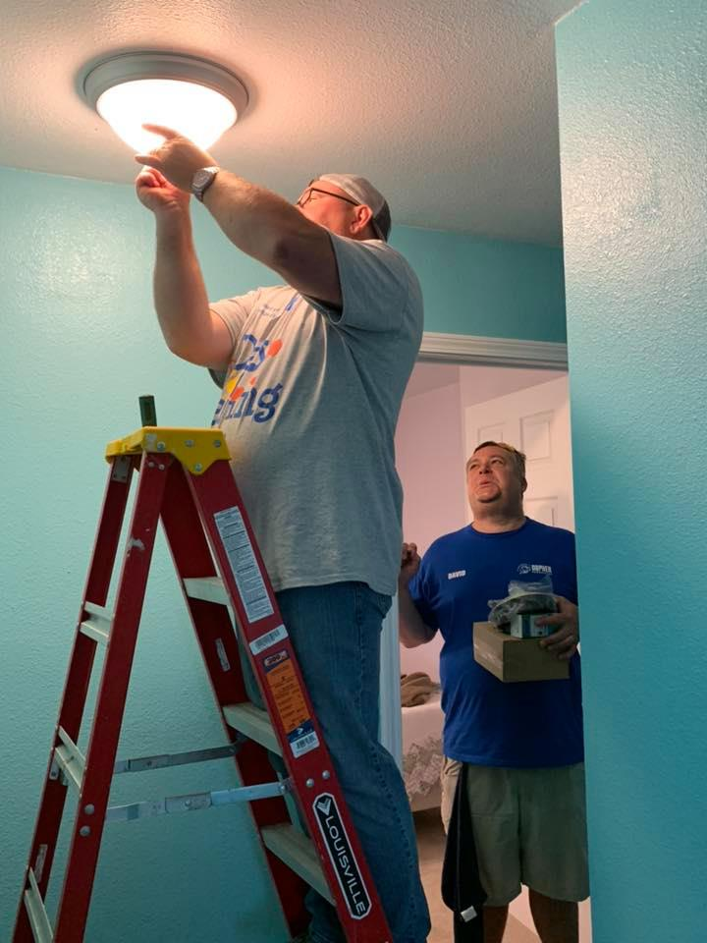
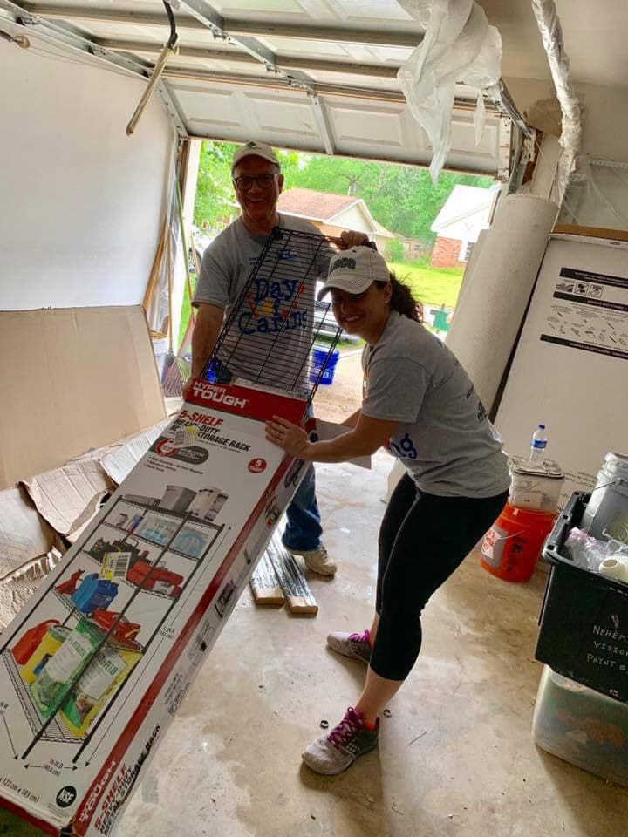
We are active in our community.

Slide 7
Your donation can help impact thousands of lives!

Slide 8
In 2018, over 9,645 Orange County residents were served through our Partner Agencies. Some of those services include…
2,810 clients provided food, clothing, furniture, utility or rent assistance.
52 families provided with palliative care for a loved one.
97,500 hot meals provided to elderly or disabled individuals.
37 clients provided overnight accommodations while they or their loved ones received medical treatments.
1,942 children housed, fed, educated, mentored, made feel safe and healthy.
87 clients assisted with income tax services.
1,249 clients provided substance treatment.
835 disabled clients served.
30 individuals helped with GED, ESL, or adult literacy.
106 clients received counseling for mental health issues.
2,735 clients received support from crisis and education regarding crisis situations.

Slide 9
Working together,

Slide 10
We can make a difference.

Slide 11
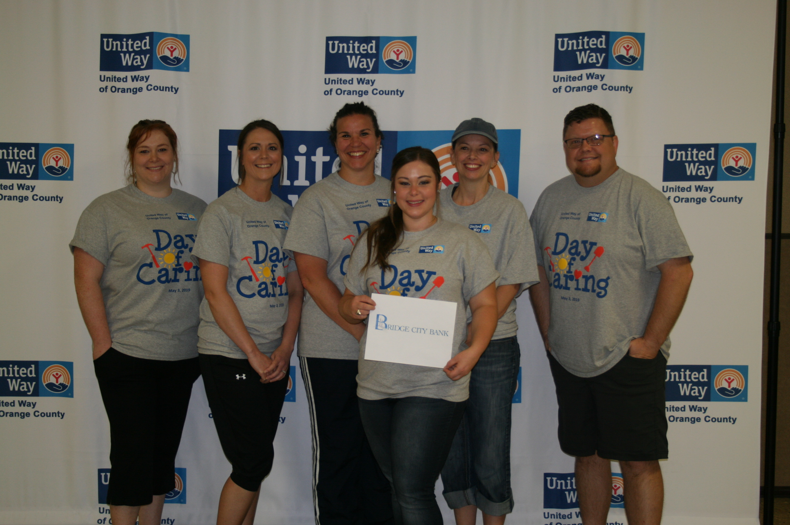
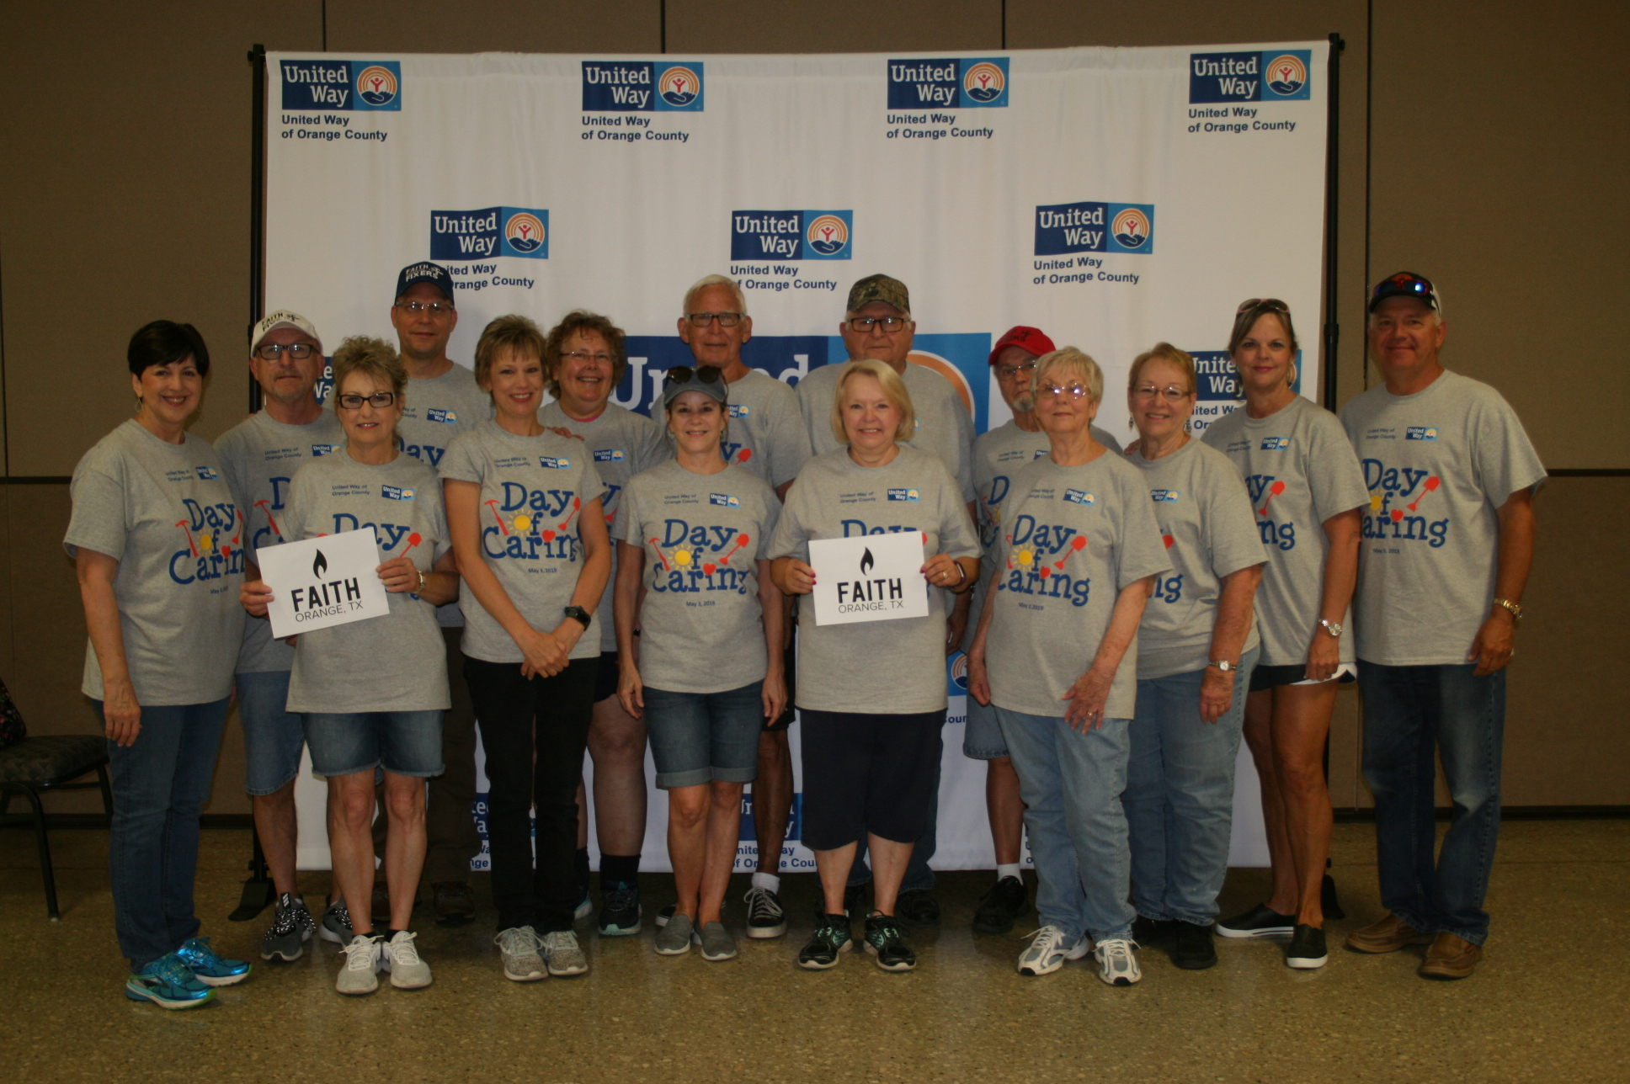
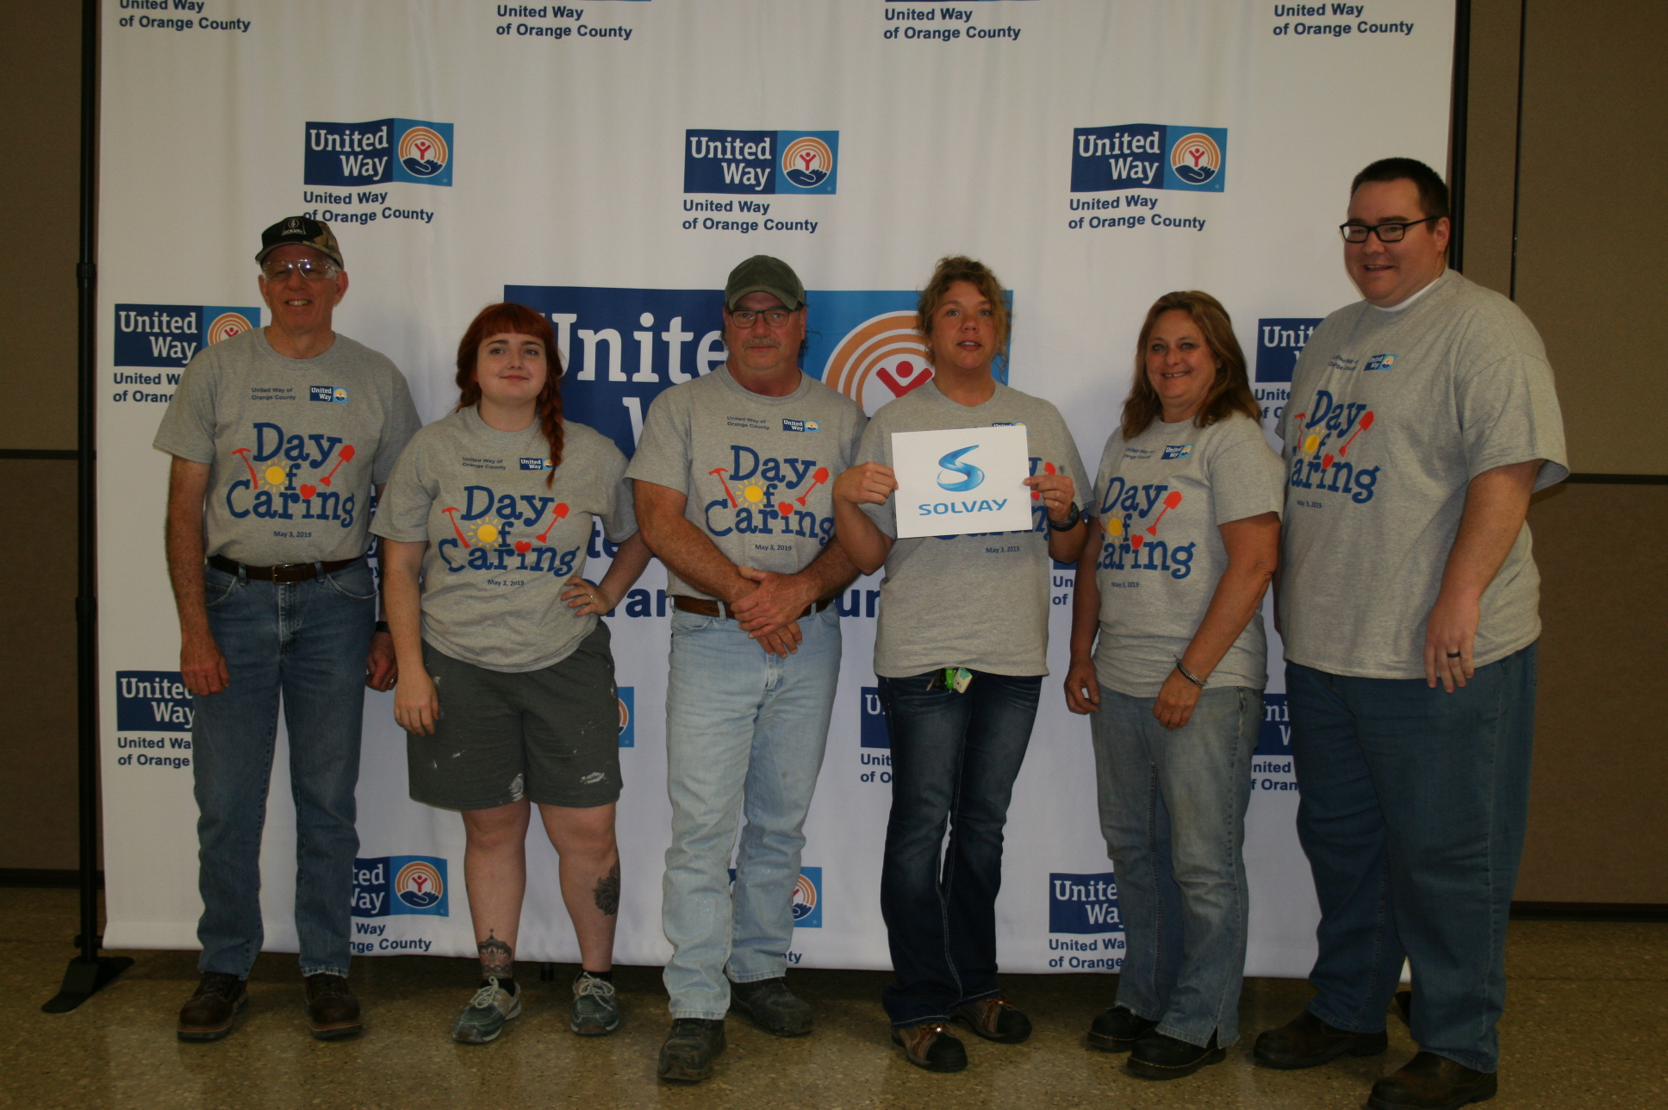
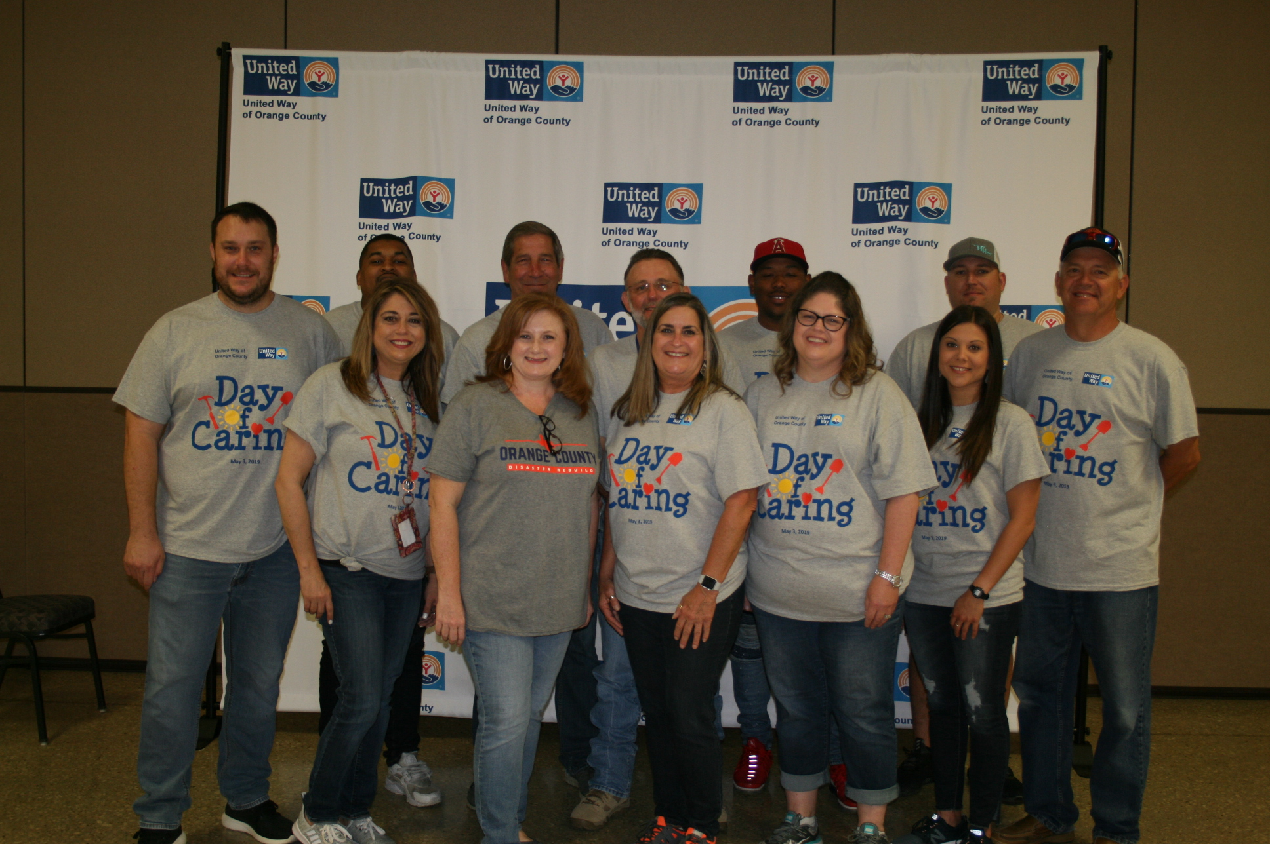
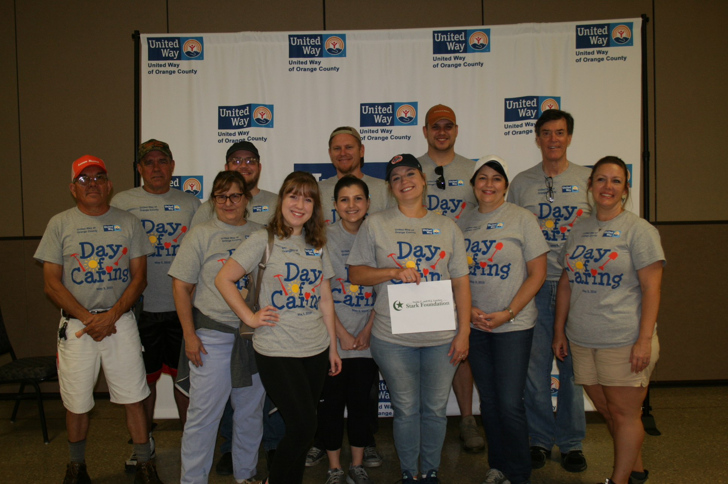
These are the faces of change.

Slide 12
You can be one too.

Slide 13
Donate through your employer, online, or mail donations.
Get informed, follow our social media, and help spread the word.
Give your time and talents to our Partner Agencies.

Slide 14
www.unitedwayorangecounty.org
409-883-3591

