Slide 1
A Year of
RENEWAL

Slide 2
United Way is a global organization that works to improve the Health, Education, and Financial Stability of every person in every community.
United Way of Orange County works on a local level to provide services to OUR community.

Slide 3
Much of this work is done through our Partner Agencies
Anayat House
Boy Scouts - Three River Council
Casa of the Sabine Neches Region
Crisis Center of Southeast Texas
Family Services of SETX (Women and Children's Shelter)
GOALS (Greater Orange Area Literacy)
Jackson Community Center
OCAA (Orange Community Action Association) - Meals on Wheels
OCARC, Inc.
Recovery Council of Southeast Texas – Right Choice of Orange County
Recovery Council of Southeast Texas - Unity Treatment Center
Salvation Army
Salvation Army Boys and Girls Club
Samaritan Counseling Center of Southeast Texas
Shorkey Center
Southeast Texas Hospice
Spindletop Center - Tejas Center
Stable-Spirit
Vidor Children's Fund
YMCA of Southeast Texas

Slide 4
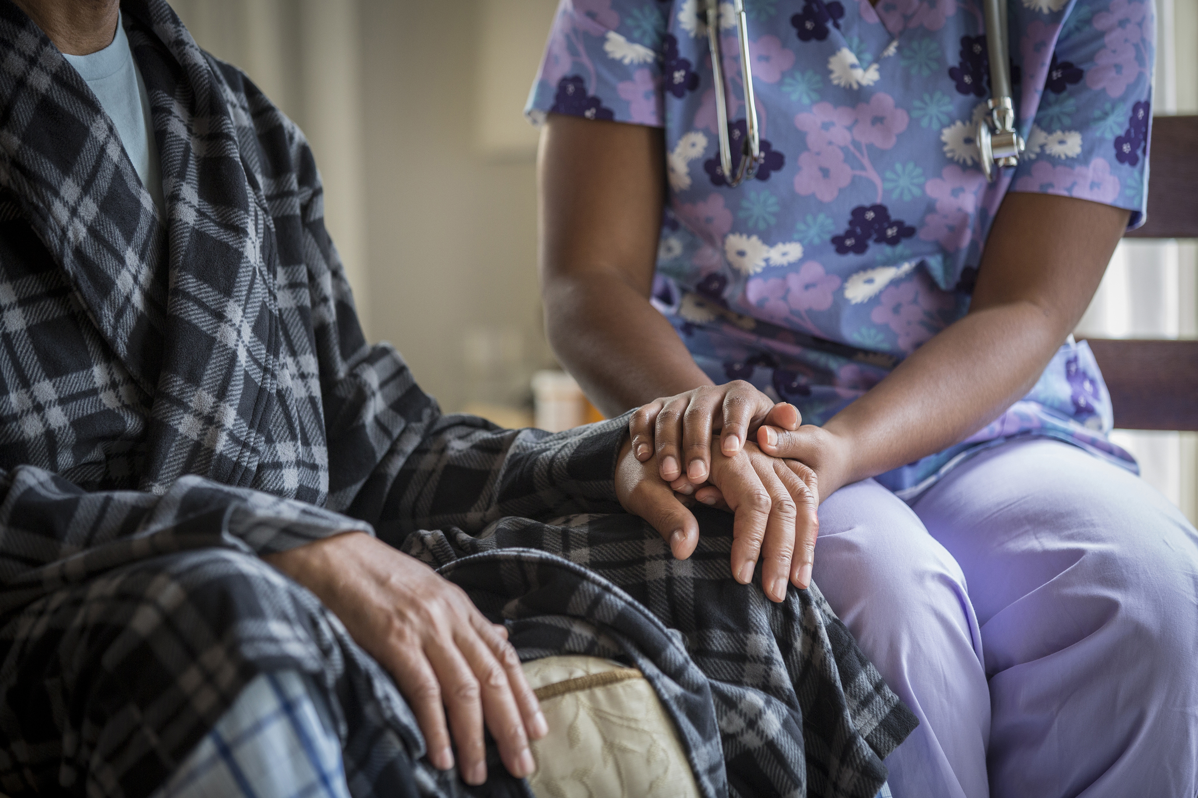
Health
We work to improve the physical and mental health, safety, and well-being of people of all ages.
Substance abuse treatment for adults and adolescents
Mental health counseling
Palliative care for end of life patients
Advocates for abused and neglected children
Medical hospitality house
Youth vegetable garden
Trauma services for victims of sexual assault
Suicide intervention
Shelter for women and children from domestic violence
Meals delivered to elderly and disabled
Men’s residential treatment facility
Physical, occupational, and speech therapies
K.I.D.D. ABA (applied behavior analysis) treatment
Equine assisted growth and learning assoc (EAGALA) services
Hippotherapy and therapeutic riding

Slide 5
Education
We work to help children, youth, and adults achieve their full potential.
GED preparation
ESL (English as a second language) classes
After school programs
Summer day camps
Leadership and mentoring
Character and skill building
Special needs vocational training
Adult basic training
Tutoring services
Youth literacy program

Slide 6
We work to promote financial stability and independence.
Housing, rent and utility assistance
Disaster and crisis assistance
Food pantry
Childcare assistance
Clothing and household items vouchers
Volunteer individual tax assistance
Financial Stability

Slide 7
Orange County Community Impact
113,880 hot meals for the elderly residents
60 families received palliative services
597 children housed, fed, and made safe
39 individuals received GED assistance
728 clients received trauma and crisis support
95 women and children provided refuge from domestic violence
194 residents received alcohol / drug counseling and treatment
222 residents received counseling for mental health issues
1,029 disabled residents served
8,715 residents provided food, clothing, utility, and rent assistance
42 residents provided with occupational therapy
In 2020, more than 12,000 Orange County residents benefited from our funded services

Slide 8
Disaster / Crisis Relief
Nearly $900,000 provided to our community for assistance after Harvey, Imelda, Laura, Winter Storm Uri and COVID-19.

Slide 9
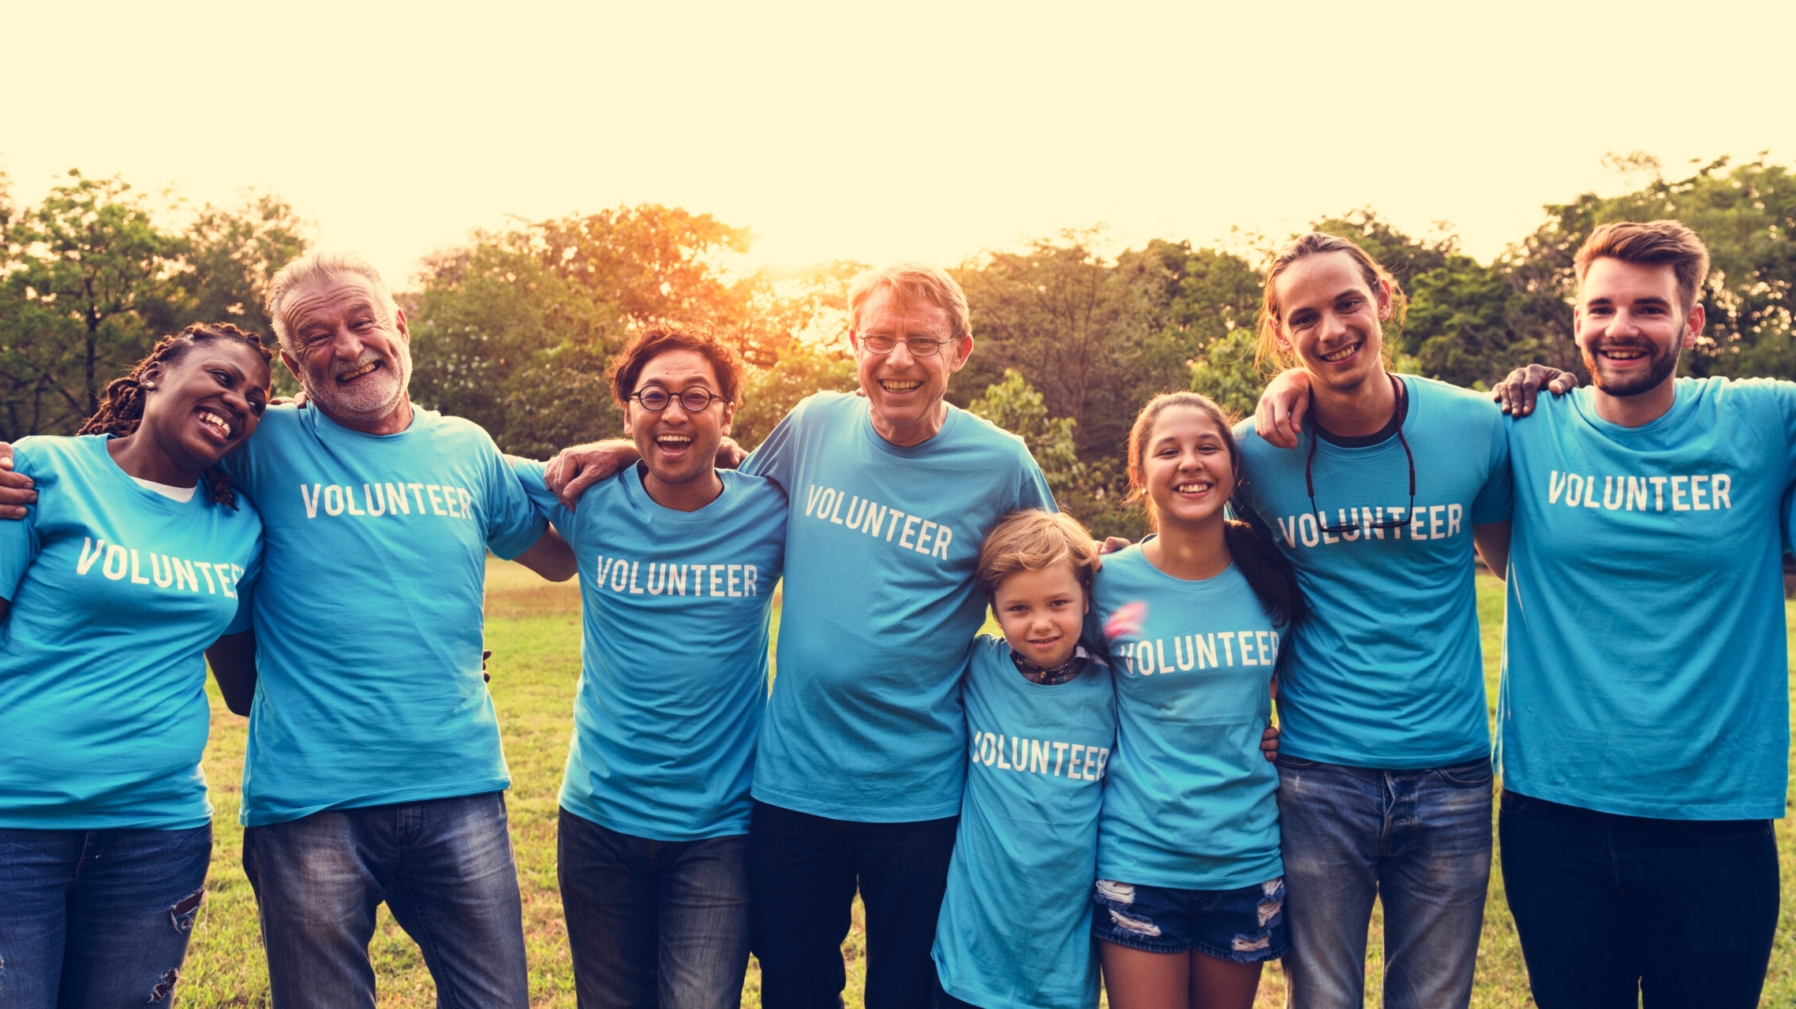
1,400 Volunteer Hours Provided in 2020

Slide 10
In addition to the collaboration with our Partner Agencies, we have many other programs to support our community.

Slide 11
EFSP (Emergency Food and Shelter Program) allows jurisdictions in the United States to receive federal funding for approved agencies which can assist individuals with food, shelter, rent and utilities.

Slide 12
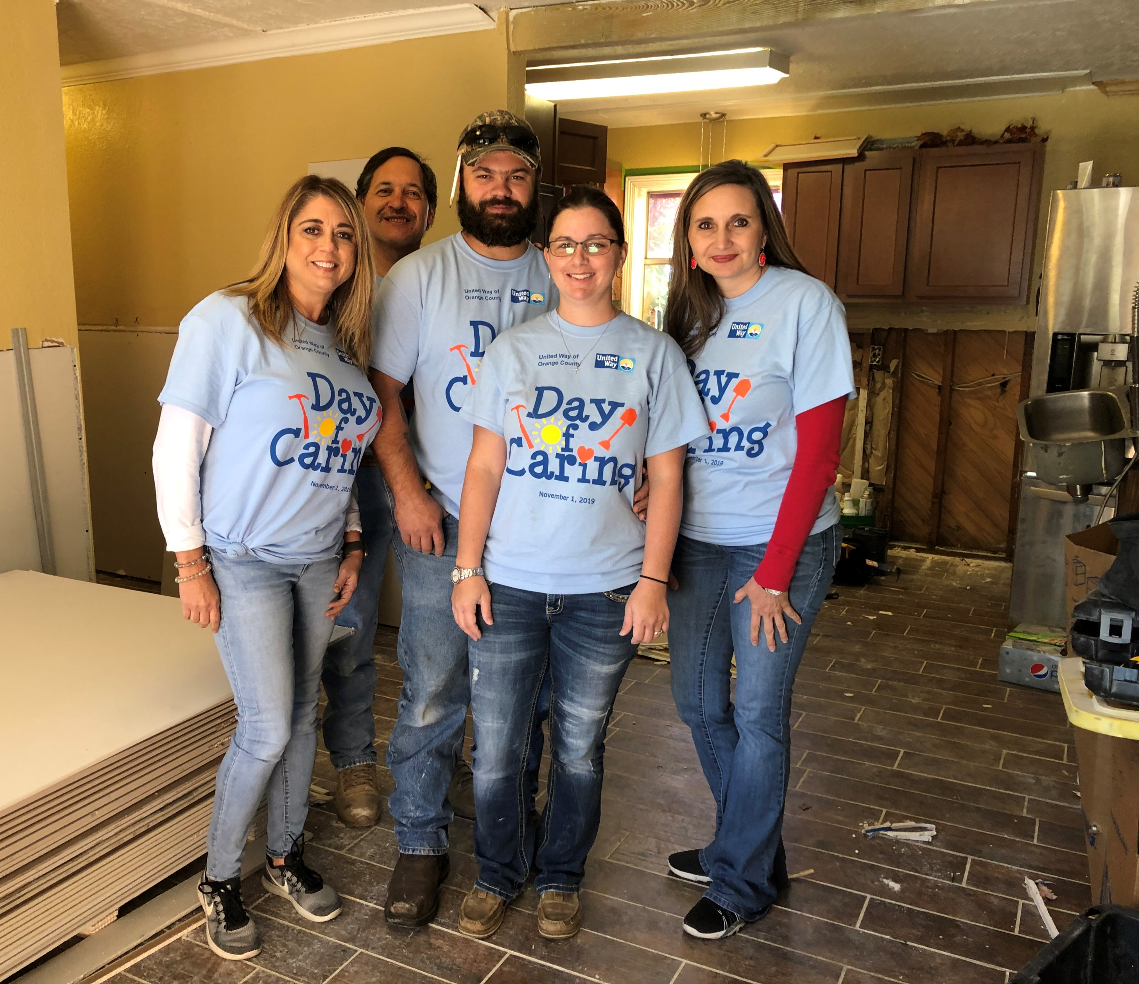
Day of Caring
An annual event where our Corporate Partners take a day to do a service project for one of our Partner Agencies or work to repair a flood-impacted home.

Slide 13
We partner with SingleCare to increase the Health and Financial Stability of families in our communities. Through their prescription savings card, SingleCare works to make prescription medications more affordable for all families, so that no one ever has to make the hard choice between the meds they need, and other basics like food or rent.

Slide 14
Why donate through United Way?
Our Partner Agencies are vetted through a very thorough application process every year. Allocations are determined based on need and those amounts are determined by a local Board.
Many companies offer a corporate match. In some cases, that means if you donate $100, your employer may match the contribution for a total donation of $200.
Some of our Partner Agencies rely heavily on funding from us. For example, 90% of the social service dollars distributed by The Salvation Army – Orange are from United Way of Orange County grants.
98.5% of Funds Stay LOCAL

Slide 15
Your Dollars Make a Difference
$25 an hour of outpatient drug/alcohol counseling
$50 one day of safe transitional housing for abused women and children
$75 three overnight stay for outpatients or caregivers using local medical facilities
$100 two days of occupational training for a client

Slide 17
GIVE – Donate through your employer, online, or mail donations. ADVOCATE – Get informed, follow our social media, and share our posts. VOLUNTEER – Give your time and talents to our Partner Agencies and special events.
Sign up today hear about volunteer opportunities!

Slide 19
www.uwoctx.org
409-883-3591

