Slide 1
2020 in Review

Slide 2
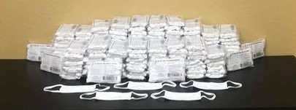
COVID-19 Relief
Provided 2,000 masks to Partner Agencies and other organizations
Distributed over $42,000 in financial assistance to Partner Agencies and impacted individuals
Organized a community food drive to serve five food pantries

Slide 3
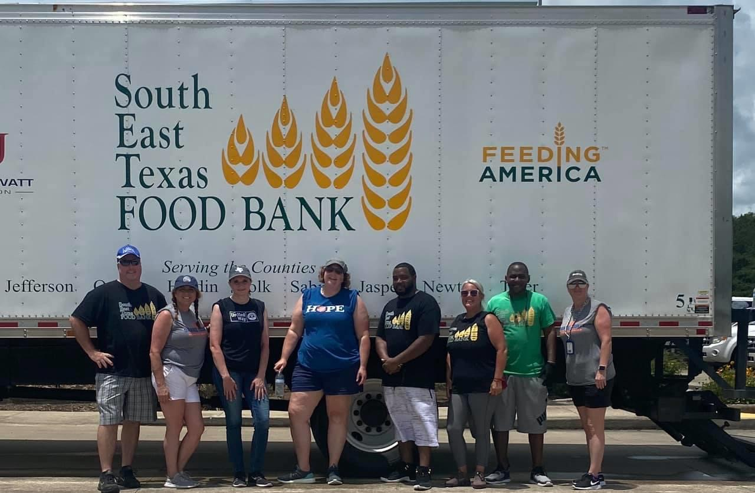
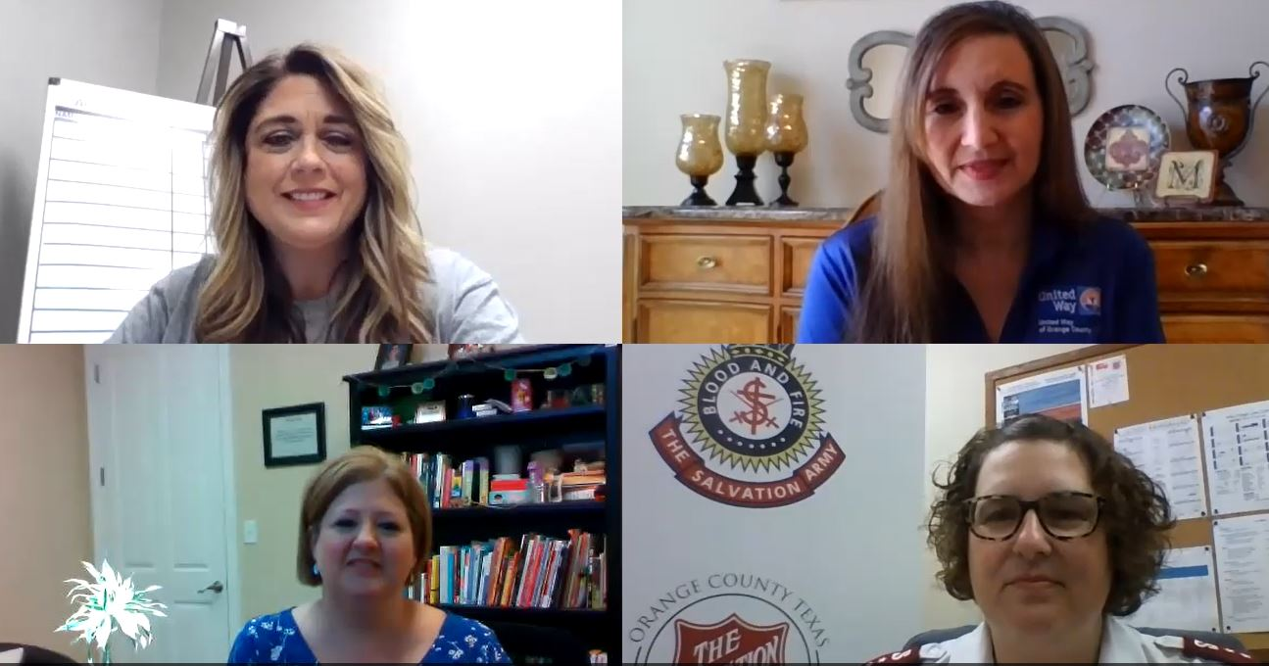
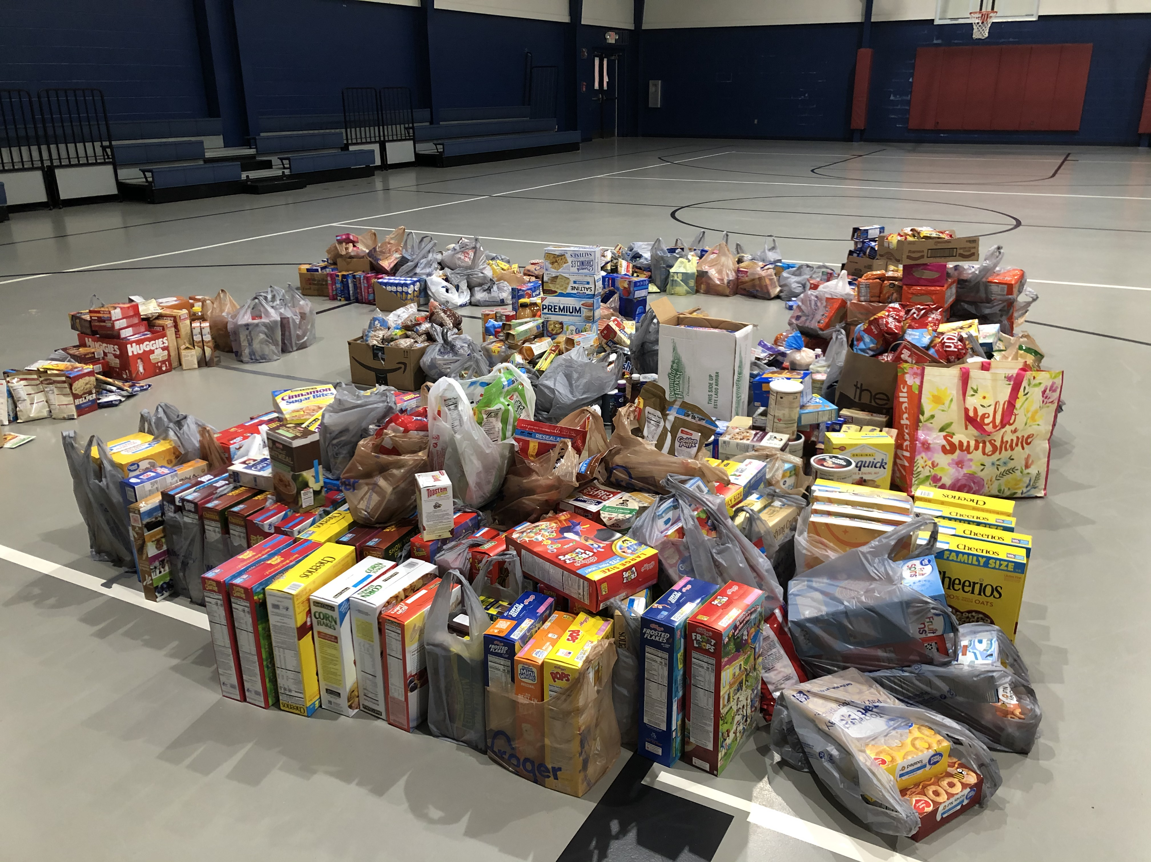
COVID-19 Relief
.
.
.
Food Distribution
Nonprofits United
Food Drive

Slide 4
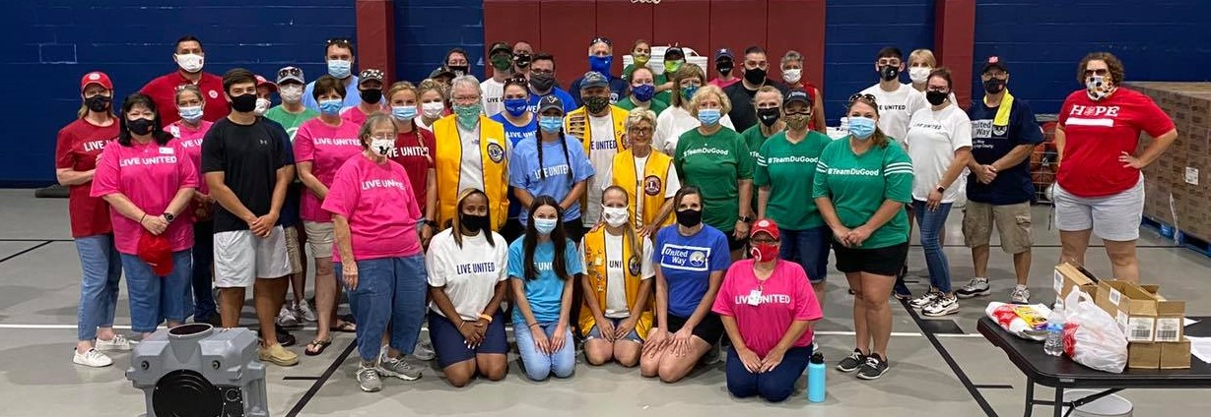
Hurricane Laura Relief

Slide 5
Hurricane Laura Relief
Established Disaster Relief Fund, raising over $92,000
Worked to secure disaster supplies receiving nearly $56,000 in donations
Coordinated over 650 volunteer hours for disaster relief
Secured volunteers and helped sort and package disaster supplies
Coordinated and worked pet food distribution
Coordinated and worked two lunches and one dinner distribution
Co-hosted major supply distribution with The Salvation Army to serve over 700 families
Coordinated over 50 volunteers for a two-day MARC event by Orange County Disaster Rebuild
Posted frequent social media updates to inform the community about resources

Slide 6
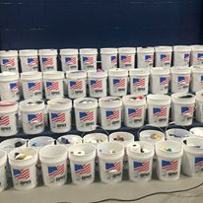
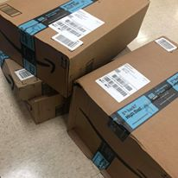
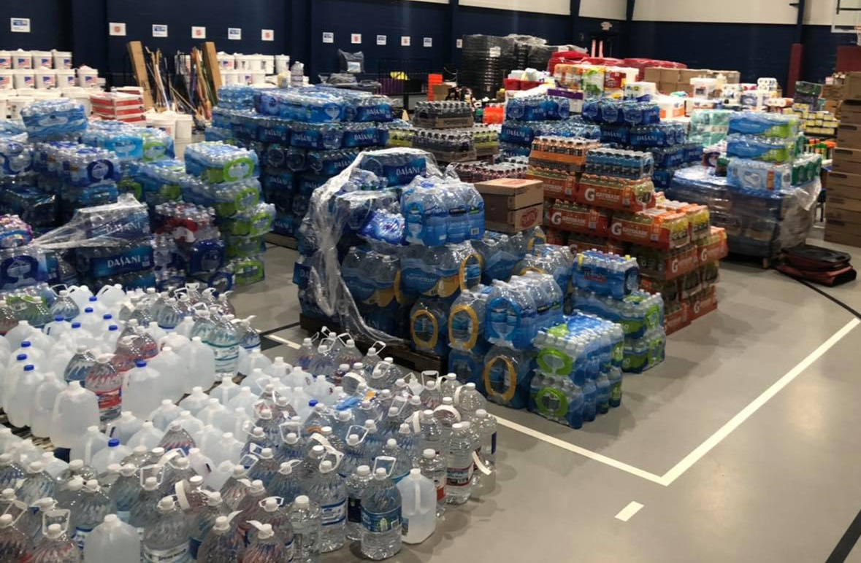
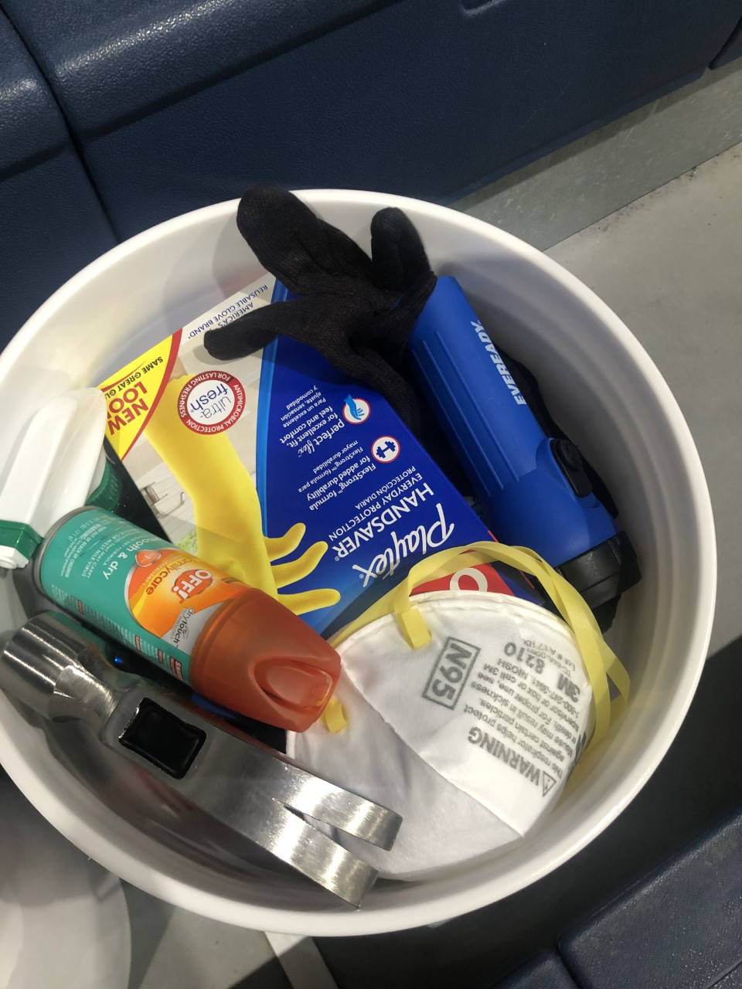
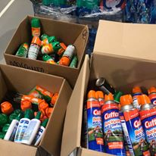
Disaster Relief Supplies

Slide 7
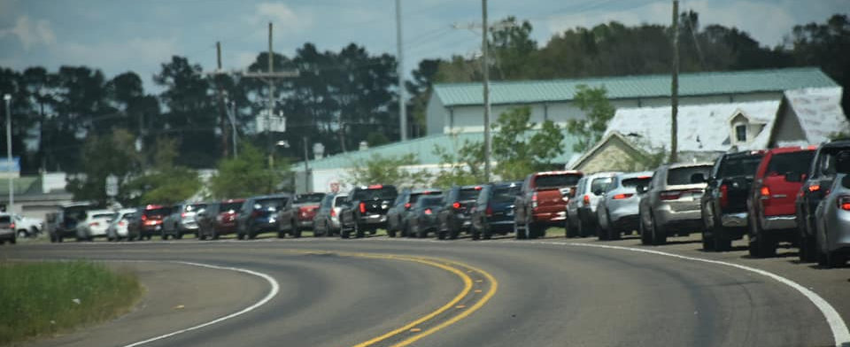
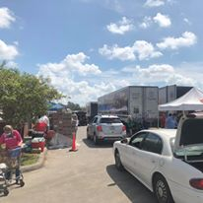
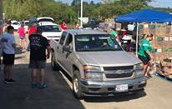
Distribution Day

Slide 8
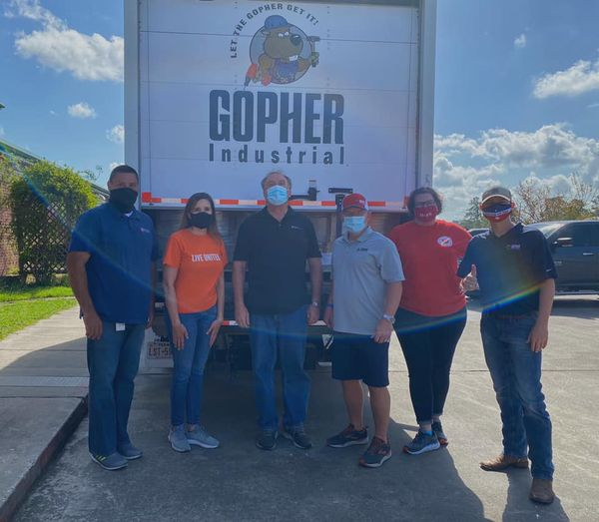
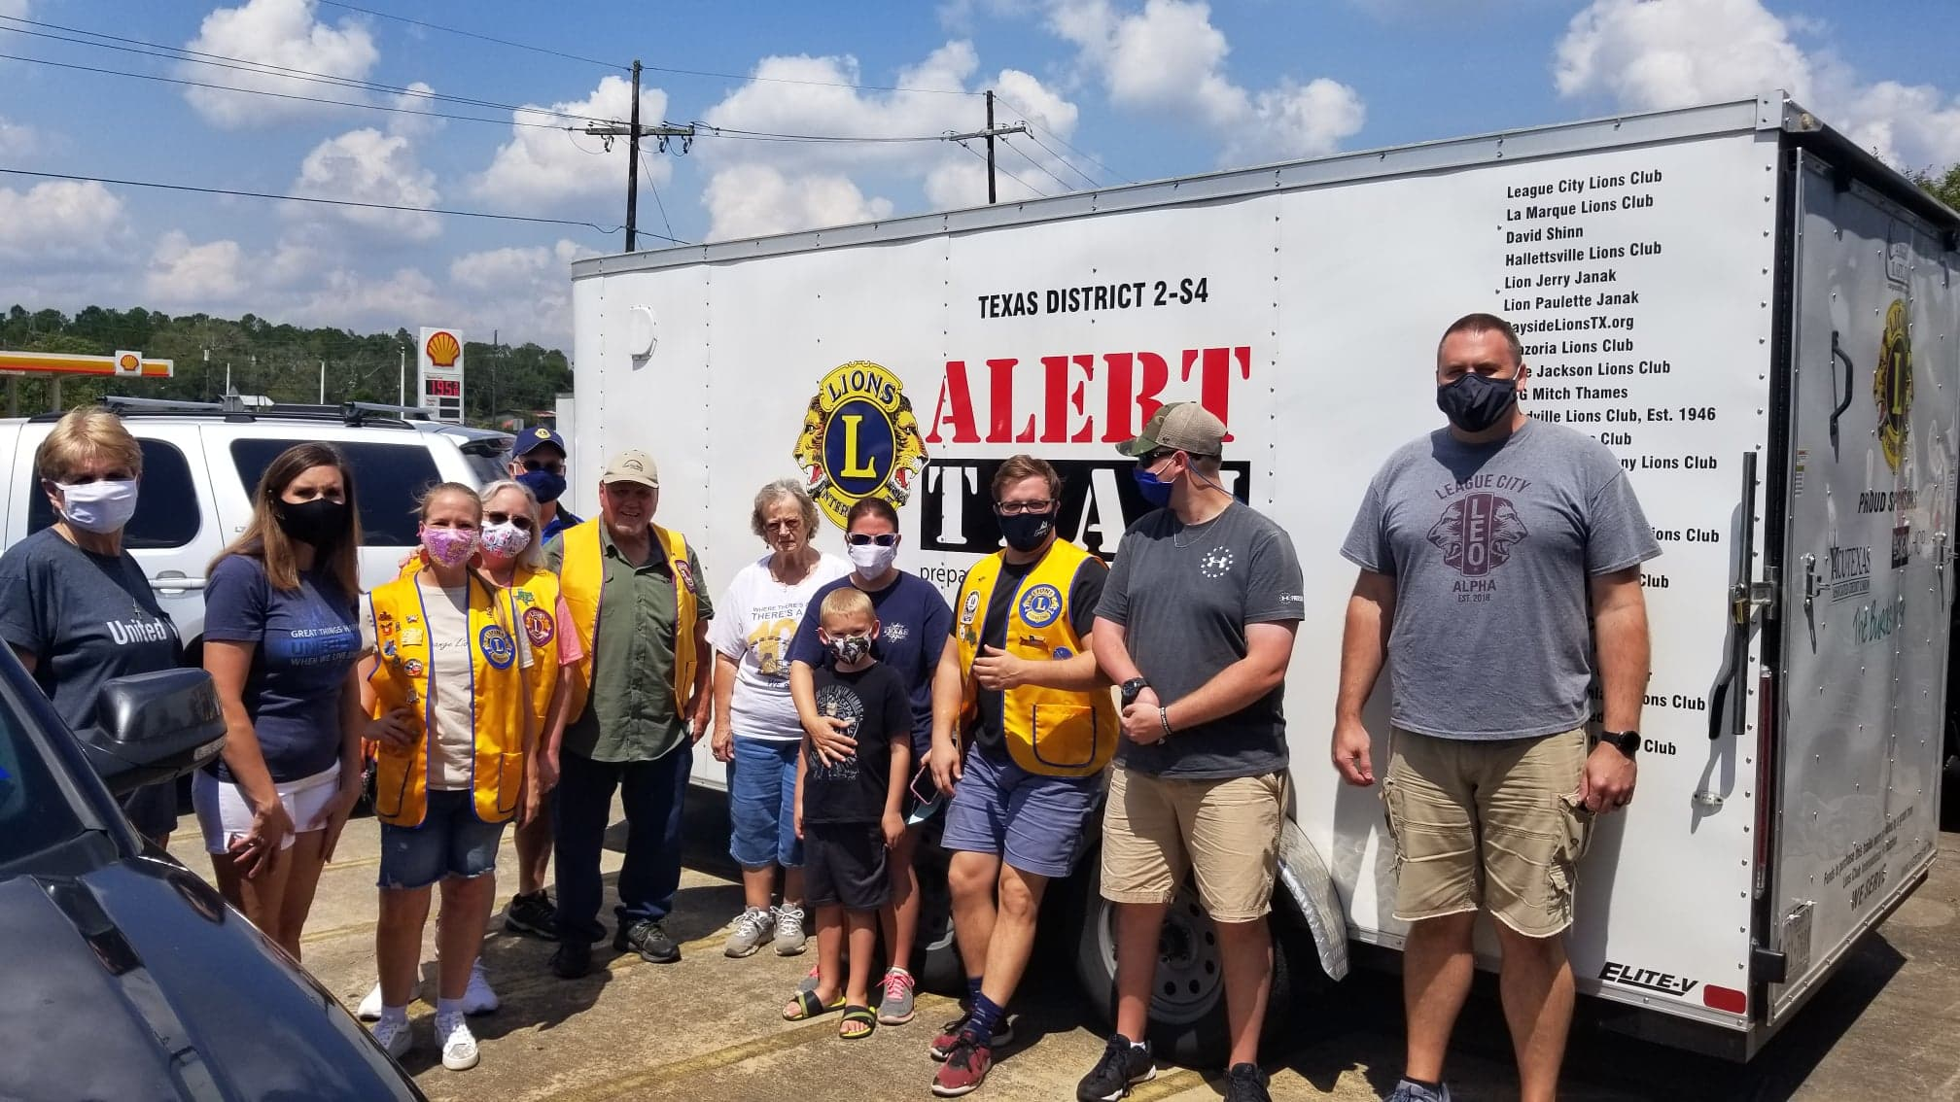
In-Kind Donations

Slide 9
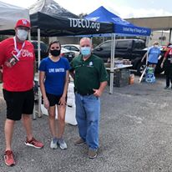
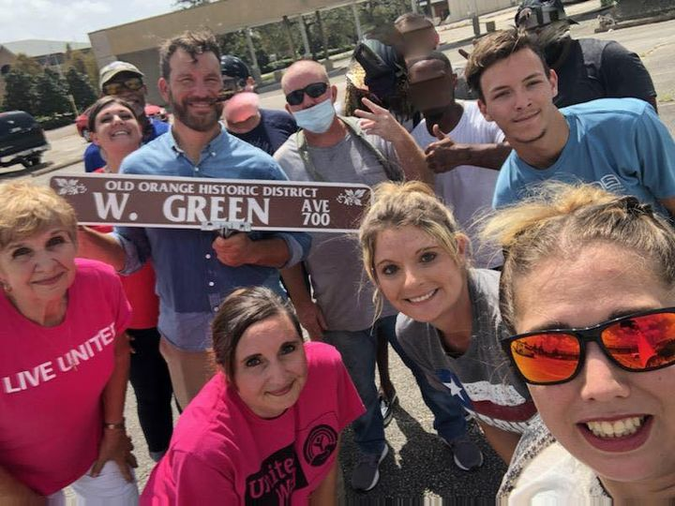
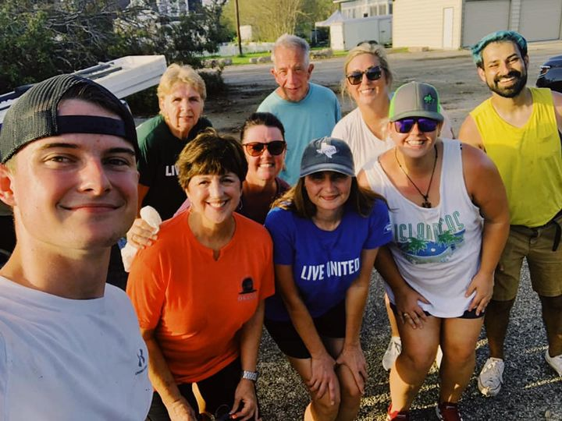
Lunch and Dinner Distributions

Slide 10
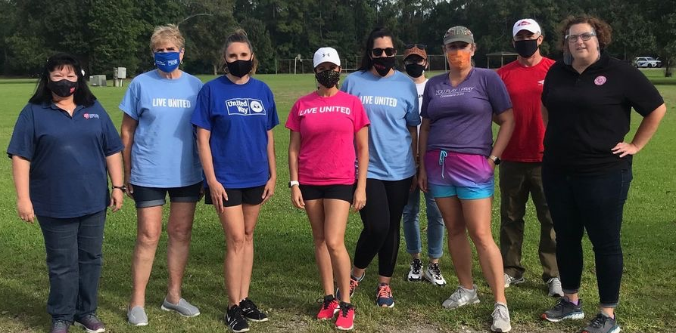
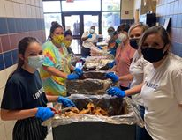
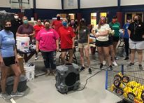
Volunteer Efforts

Slide 11
TOTAL DISASTER RELIEF FUNDING
$714,012.61 for Harvey
$45,250.00 for Imelda
$42,135.66 for COVID-19
$92,065.77 for Laura_________
$893,464.04

Slide 12
With safety concerns regarding COVID-19, we converted our Day of Caring to a virtual format. Our Corporate Partners and Community Members assisted nine Partner Agencies with projects to support their clients.

Slide 13
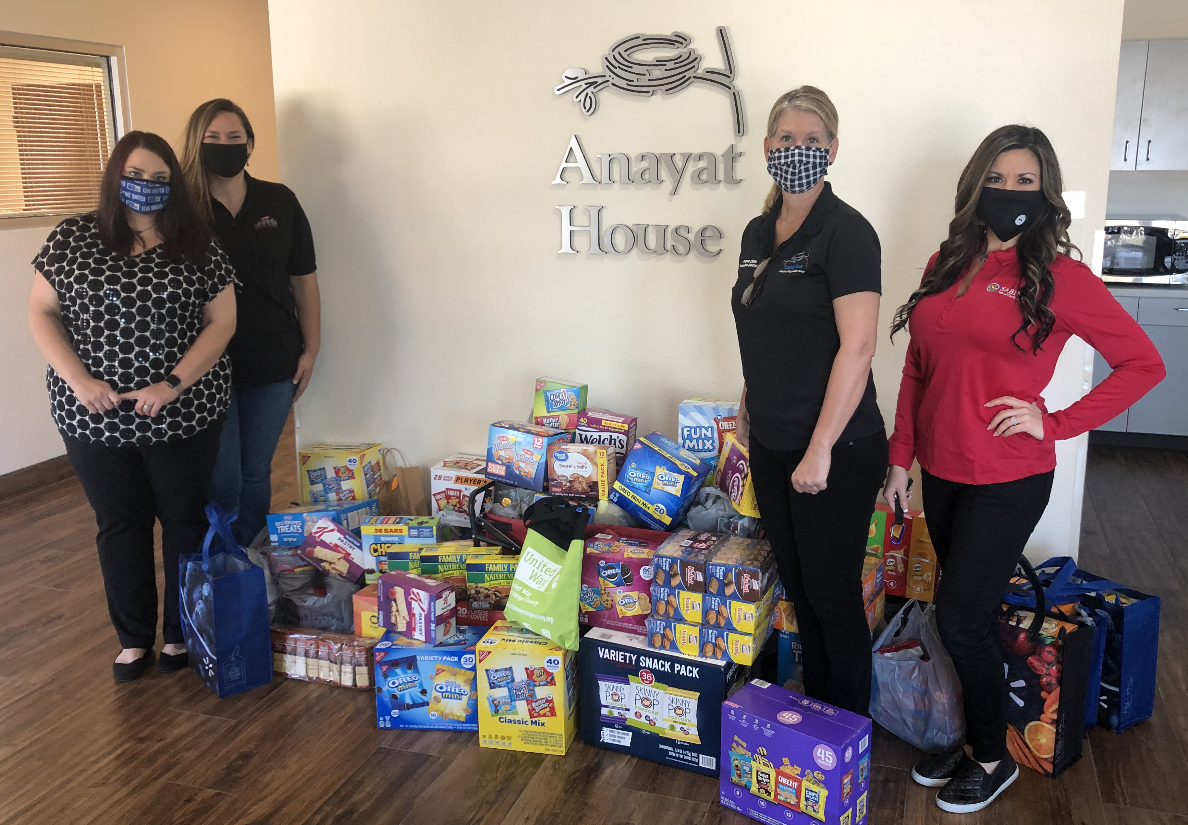
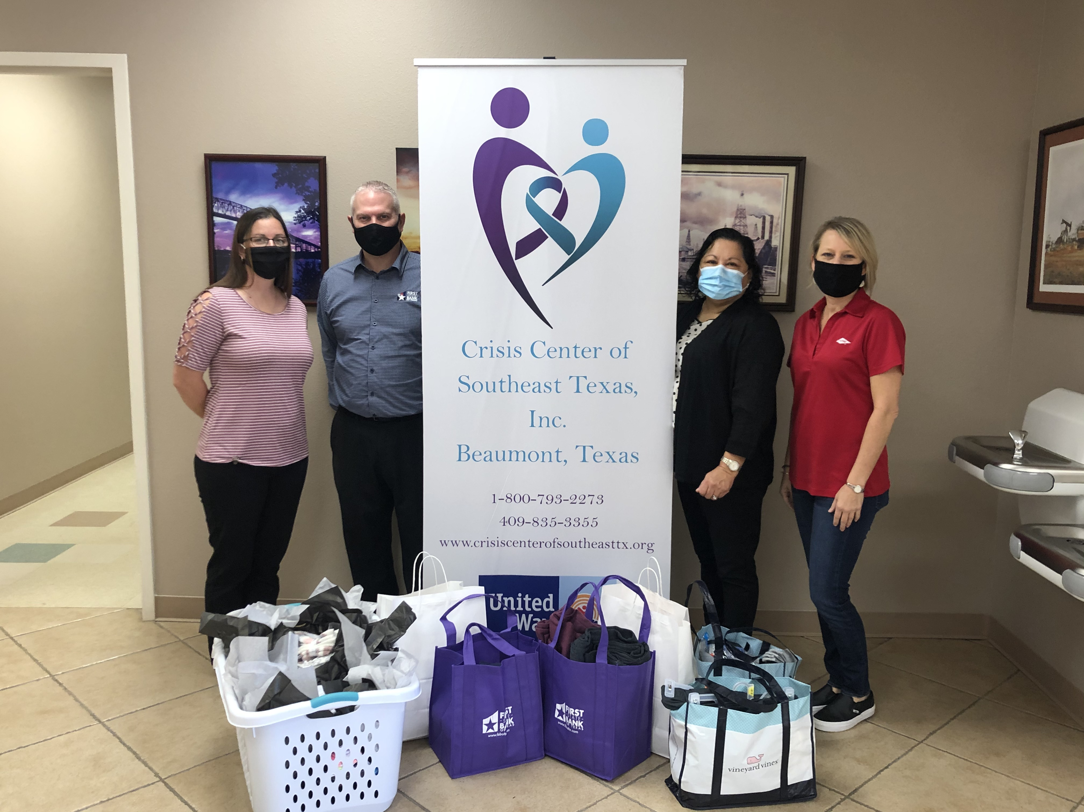
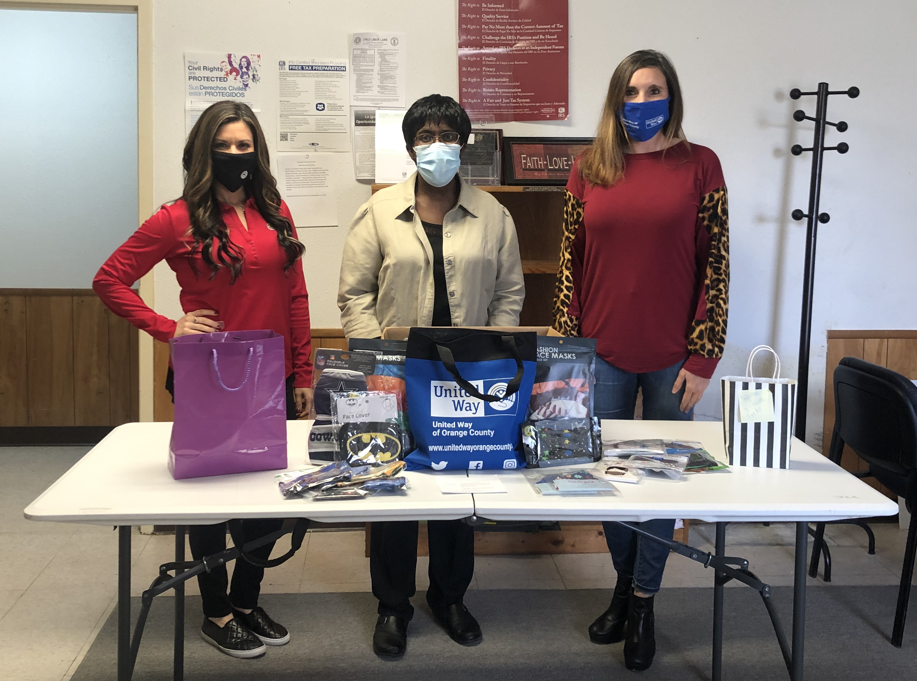
.
.
.
Anayat House
Crisis Center of SETX
Jackson Community Center

Slide 14
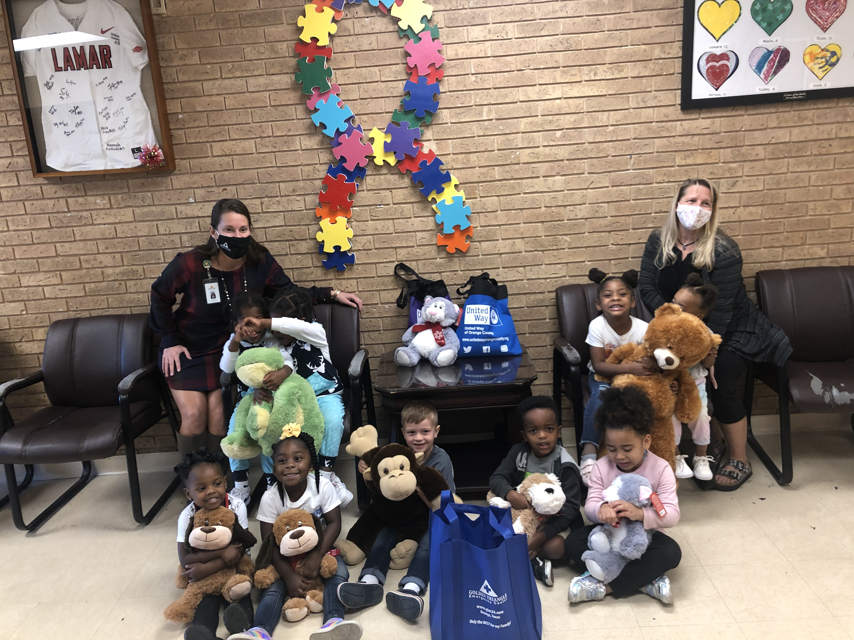
.
.
.
Salvation Army
Salvation Army Boys & Girls Club
Shorkey Center

Slide 15
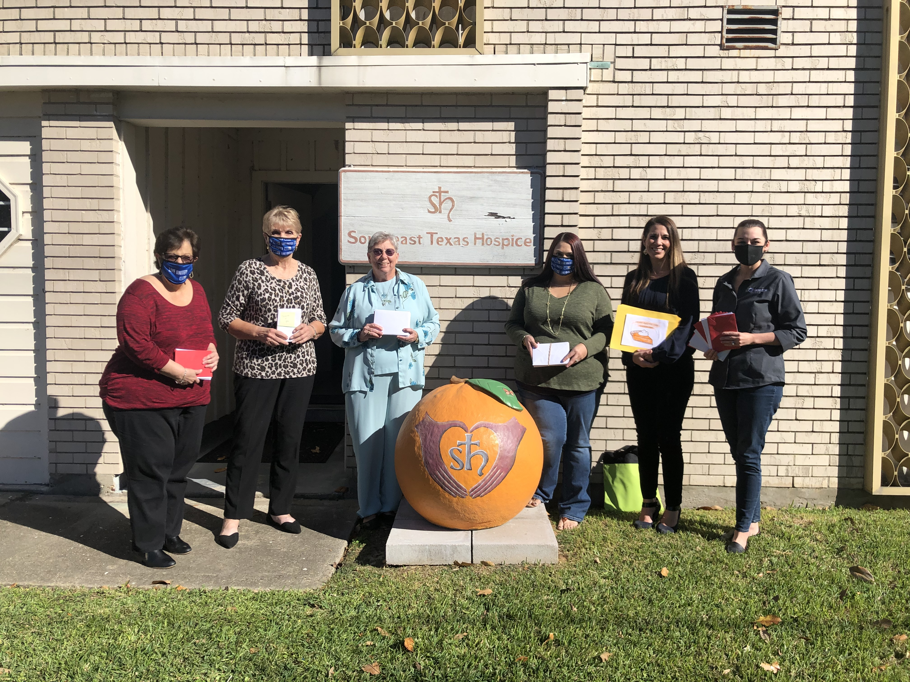
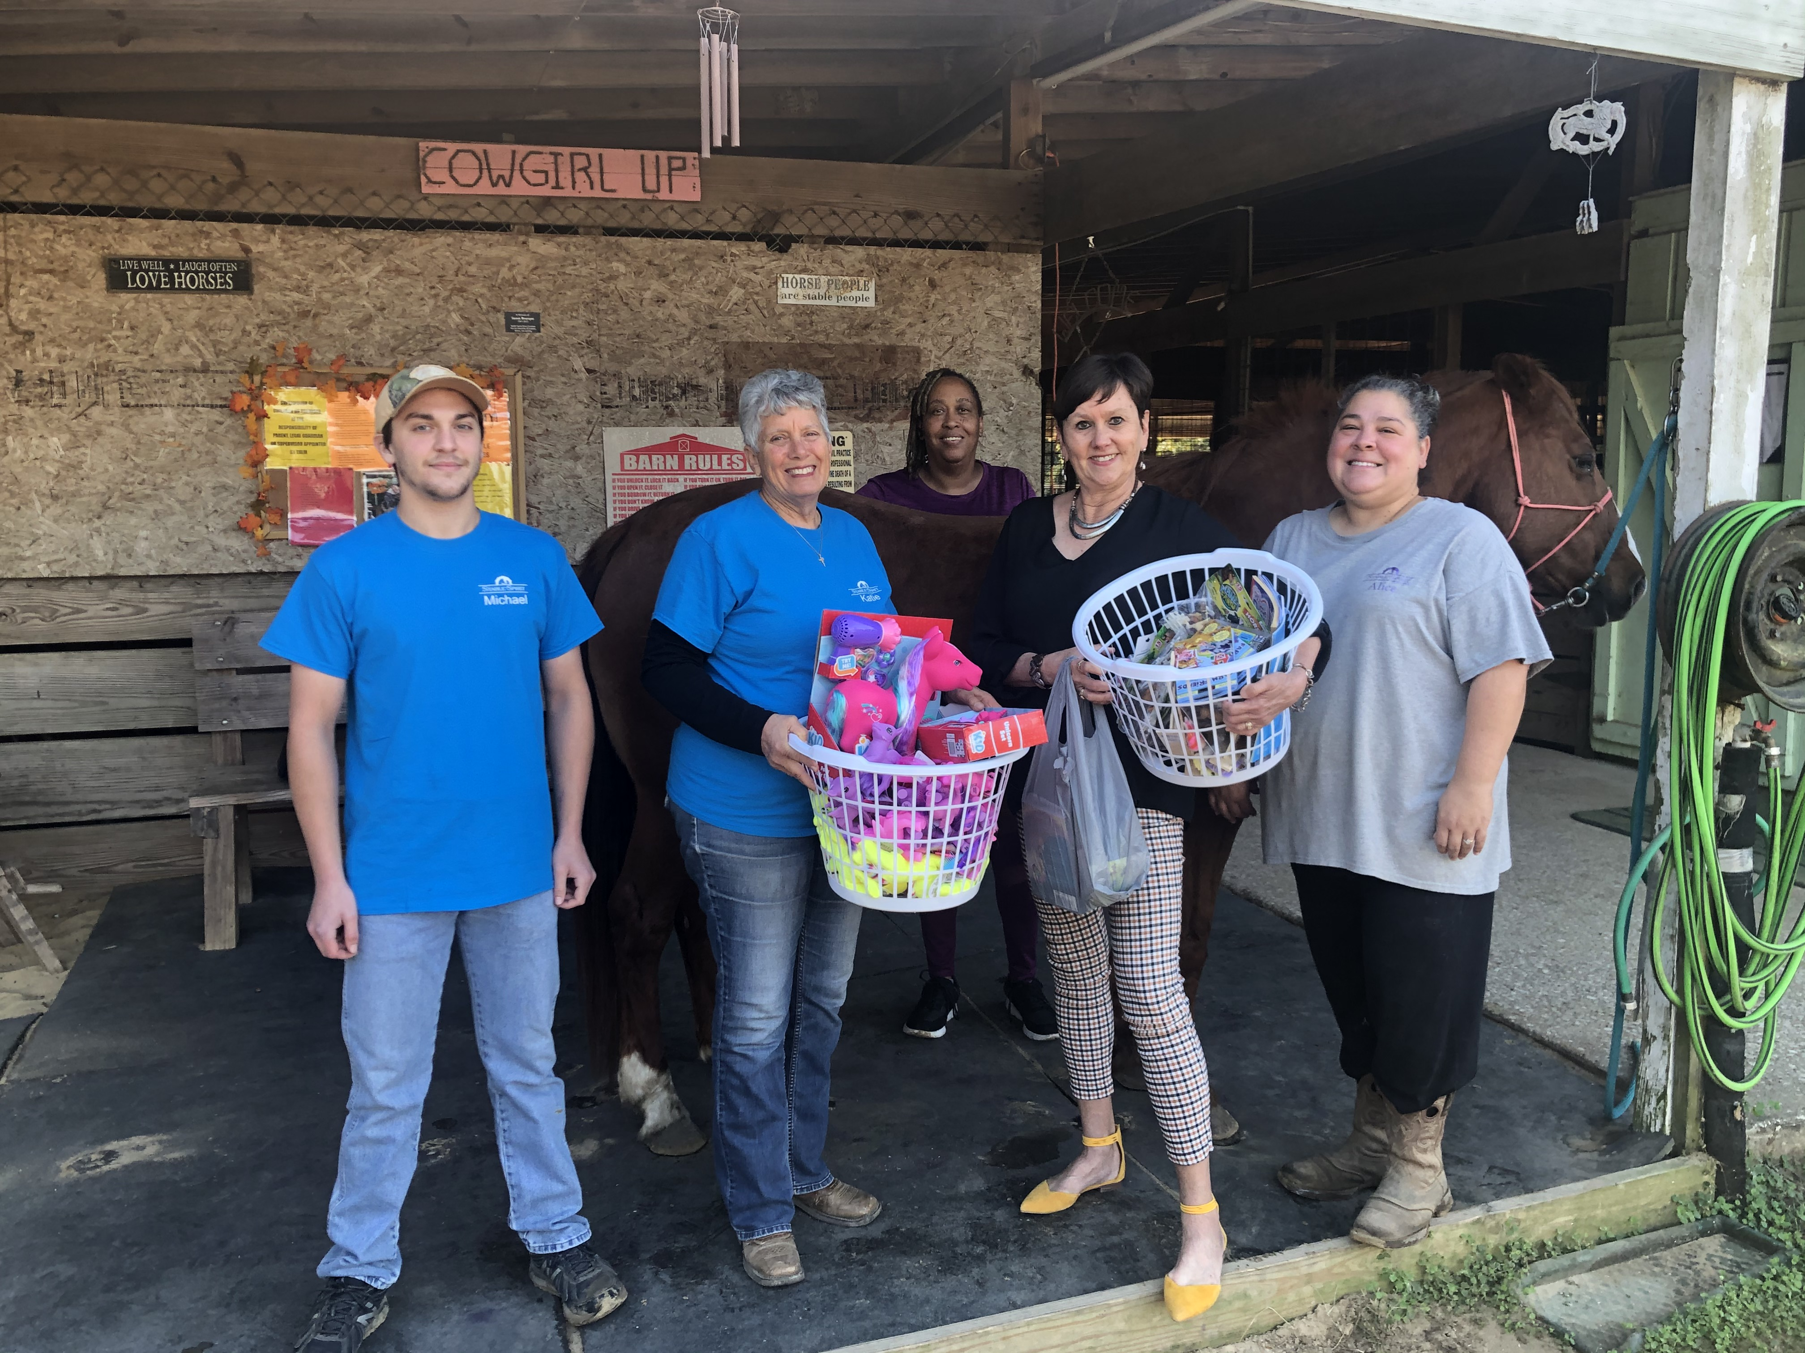
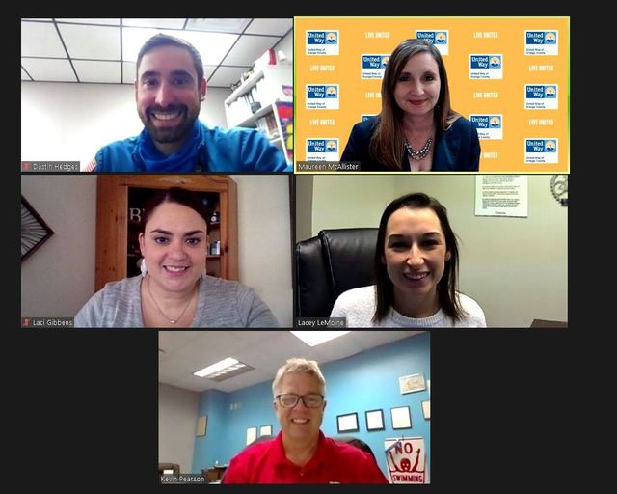
.
.
.
Southeast Texas Hospice
Stable-Spirit
YMCA of SETX

Slide 16
Partner Agencies 2021

Slide 17
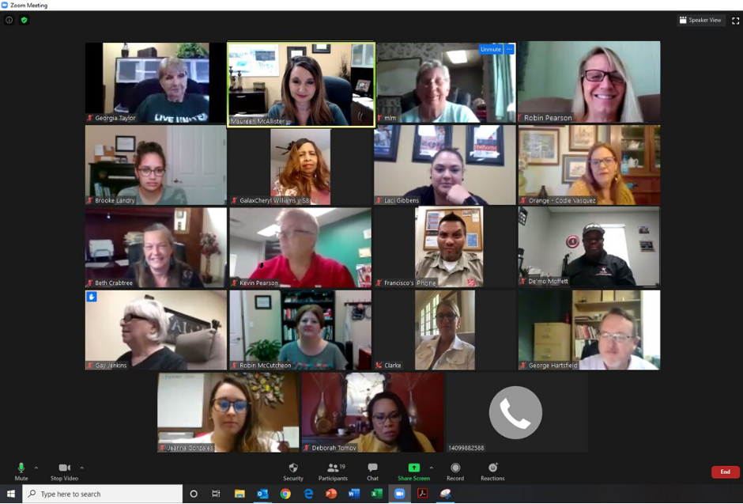
Agency Collaboration

Slide 18
2020 Board of Directors
Brian Beach, Retired
Michael Bearden, LyondellBasell
Stacey Brister, Little Cypress-Mauriceville CISD
Jennifer Burtsfield, River Trust Capital Management
Jana Clark, Akrotex
Patty Collins, Lamar State College Orange
Mike Culbertson, International Paper
Charley Elkins, First State Bank
Kathy Flanigan, First Financial Bank
Brenda Foreman, Bridge City Bank
Rickie Harris, West Orange Cove CISD
Dustin Hedges, Dow
Sherry Hommel, RE/MAX
Joe Love, First Financial Bank
Keith Love, International Paper
Jim Malain, Entergy
Christi Moerbe, Retired
Amy Peevey, Johnson's Mini-Storage
Kristen Placette, Sabine FCU
Manuel Ramon, Texas Department of Transportation/Travel Center
Dr. George Russell, INVISTA
Gina Simar, Lamar State College Orange
Dayna Smith, Orangefield ISD
Erin Talley, Chevron Phillips Chemical Company
Dave Young, Retired

Slide 19
OUR TEAM
Maureen McAllister
Georgia Taylor
Laci Gibbens
President & CEO
Secretary/Bookkeeper
Corporate Volunteer Manager

